Slide 1








Highway Accident Analysis in India | 2018-2022
ADS Foundation workshop
Author:ADARSH AHUJA
Source: MoRTH / PIB

Slide 2
Understand the reported National Highway accident trend from 2018 to 2022
QUESTIONS
Three questions frame the analysis
Source: MoRTH / PIB
01
02
Identify states with higher reported National Highway accident counts
03
Compare the National Highway share with all-road totals
Interpretation stays descriptive: aggregated annual reporting, not individual crash data.
2

Slide 3
MoRTH Road Accidents in India 2022
DATASET
The dataset combines annual totals with a focused highway view
Source: MoRTH / PIB
Annual state/UT all-road accidents, fatalities, and injuries for 2018-2022
India-wide National Highway accident counts for 2018-2022
2022 top-10 states' National Highway accident counts for 2018-2022
National Highway fatalities for 2022
Scope note: the state-level National Highway series covers the report's top ten only, not all states.
2

Slide 4
From raw CSV to a Power BI dashboard
WORKFLOW
01 02 03 04
05
Raw CSV
Python Pandas/NumPy cleaning and validation
SQL tables, joins, GROUP BY, CASE,
and KPIs
Power BI model and DAX
Dashboard
Handle missing values explicitly Check duplicate state-year keys
Source: MoRTH / PIB
Null does not mean zero
2

Slide 5


National Highway accidents rebounded sharply in 2022
NATIONAL HIGHWAYS
Accidents
2018: 140,843 | 2019: 137,191 | 2020:
116,496 | 2021: 128,825 | 2022: 151,997
152k
141k
137k
150k
129k
2022 was 18.0% above 2021
116k
100k
2022 was 7.9% above 2018
Source: MoRTH / PIB
50k
0
2018
2019
2020
Year
2021
2022
2

Slide 6
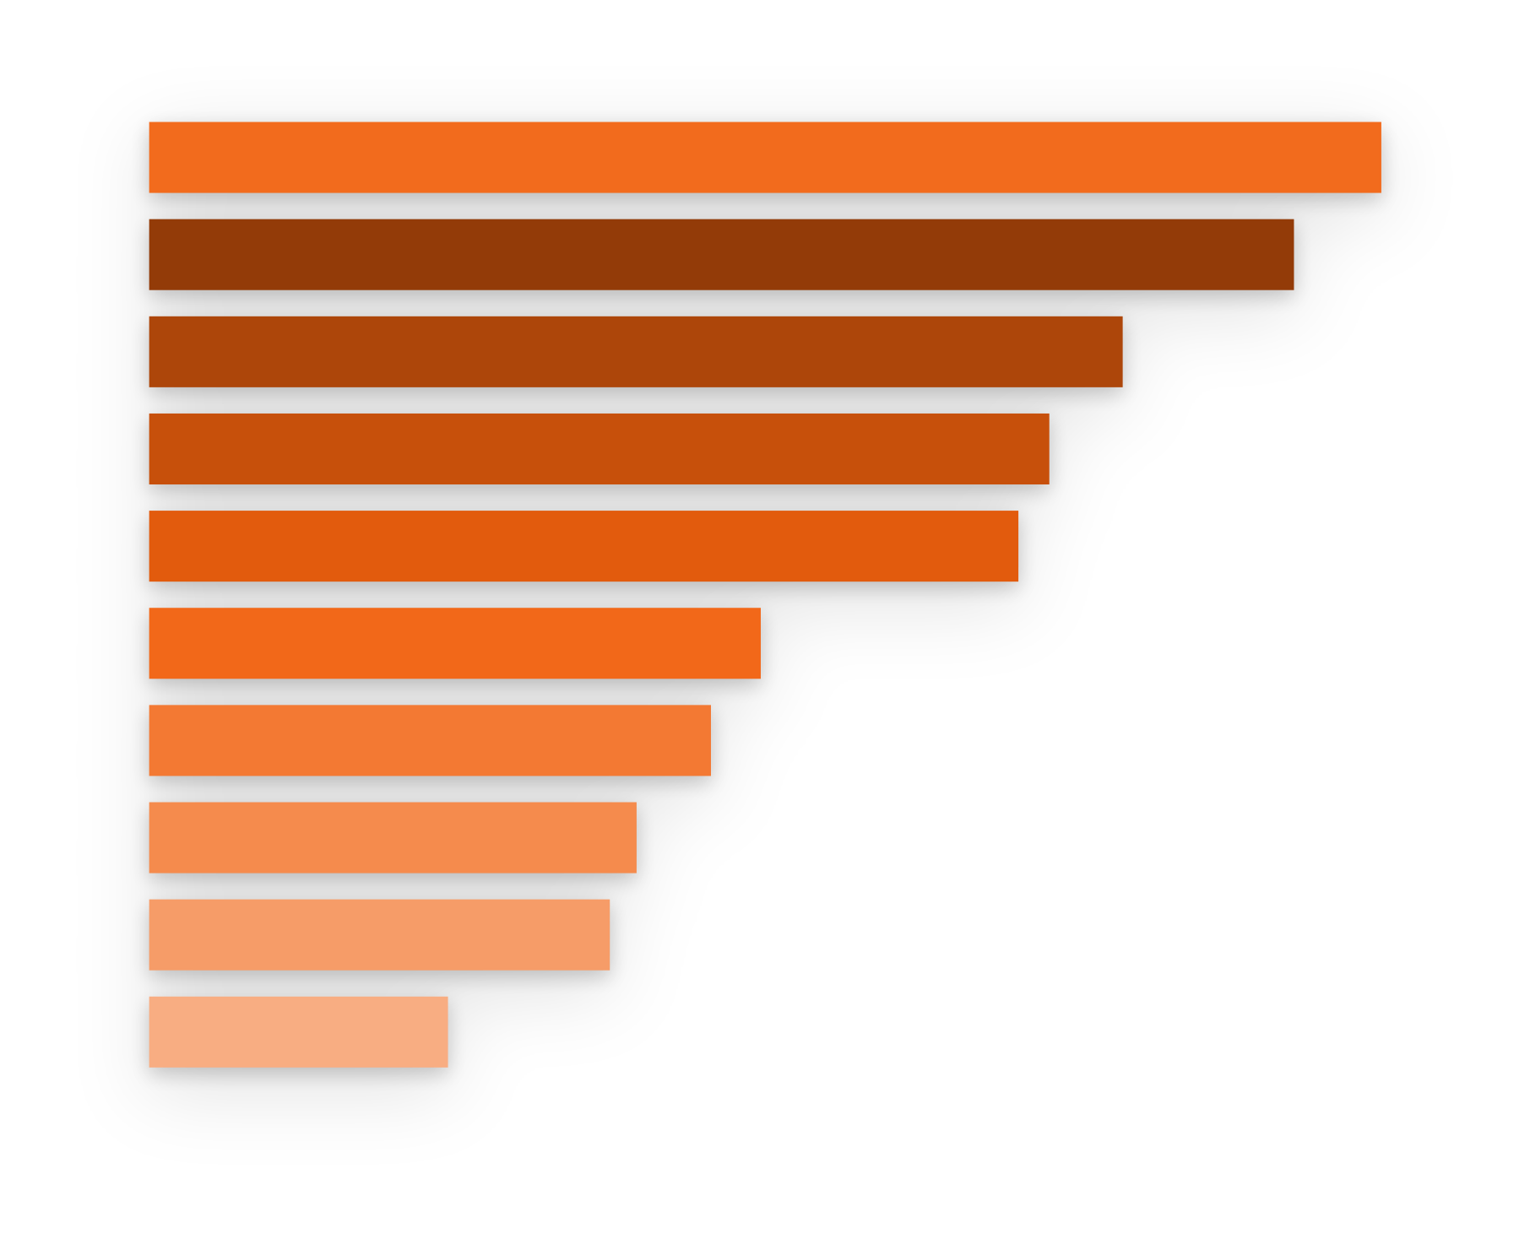


Tamil Nadu and Kerala lead the report's 2022 top-ten ranking
2022 TOP TEN
Ranked 2022 National Highway accidents: Tamil Nadu 18,972; Kerala 17,627; Uttar Pradesh 14,990; Madhya Pradesh 13,860;
Karnataka 13,384; Maharashtra
9,417; Andhra Pradesh 8,650;
Telangana 7,505; Rajasthan
7,093; Bihar 4,601.
State
Tamil Nadu
Kerala Uttar Pradesh Madhya Pradesh
Karnataka Maharashtra Andhra Pradesh
Telangana Rajasthan
Bihar
4.6k | 9.42k 8.65k 7.51k 7.09k | 15k 13.9k 13.4k | 19k 17.6k
Scope note: these are the report's top ten states, not all states.
Source: MoRTH / PIB
0
5k
10k Accidents
15k
20k
2

Slide 7
SHARE OF NATIONAL TOTALS
Road group | Accidents | Fatalities
All roads | 461,312 | 168,491
National Highways | 151,997 | 61,038
National Highways carry a larger share of fatalities than accidents
32.94%
Accident share
36.22%
Fatality share
including Expressways
Takeaway: fatality share is higher than accident share. Counts are not exposure-adjusted risk rates.
Source: MoRTH / PIB
2

Slide 8
Use the dashboard to connect the workflow to three findings
PROPOSED DASHBOARD LAYOUT
Proposed dashboard layout — not a live Power BI screenshot.
2022 NH accidents
2022 NH fatalities
NH accident share
NH fatality share
NH trend line and ranked top-ten state bars
Year slicer; state filtering only where the data supports it
NH accidents rebounded in 2022
Tamil Nadu had the largest NH count among the report's top ten
NH fatality share exceeded its accident share
Future scope: add district/route-level e-DAR data, traffic volume, and highway length; add other variables only when sourced reliably. Scope note: state-level NH counts cover the report's top ten only.
Thank you
Source: MoRTH / PIB
2

